Slide 1
Lecture 3
Operators & Decision Statements

Slide 2
Expressions
C++ allows us to create complex mathematical expressions by combining variables and literals with operators
An expression is a statement that has a value
An expression never appears on the left hand side of an assignment statement
x + y + 17 = 0;

Slide 3
Part of an expression
An expression can be a combination of the following elements
Literal : 17, 2.54, ‘C’, “hello”
Variable : x, numberOfFriends
Operators : +, -, <, >
a = 17;
b = 17 + a;
c = 5 + 2 * numberOfFriends - 4 / 10;

Slide 4
Expression I/O
cout will output the value of an expression:
cout << 17 * 3 - 9 << endl;
It displays 42
We can also do chained output of expressions:
cout << "Its " << 9-1 << “pm”;
It displays Its 8 pm

Slide 5
Expression I/O
Extractions on cin can also be chained to request more than one datum in a single statement.
cin >> a >> b;
This is equivalent to:
cin >> a;
cin >> b;

Slide 6
Expression I/O
We can not use expression in the same way with cin.
cin >> 17;
cin >> x + 17;
What is the problem?

Slide 7
Advantage of using expression
Expressions can:
Shorten the length of a program
Reduce the need for some variables
Sometimes make it easier to follow the logic

Slide 8
Operators
An operator is a symbol that tells the compiler to perform specific mathematical or logical manipulations. We can divide operator in C++ into 3 main categories-
Unary Operators
Binary Operators
Ternary Operators

Slide 9
Unary Operators
Operators that operates or works with a single operand are unary operators.
For example: (++ ,--)

Slide 10
Post-increment operator
Addition of 1 to a variable is done so frequently in programs that we have a special operator for that purpose
x = x + 1; is equivalent to x++;
x = x - 1; is equivalent to x--;
int x = 5;
cout<<x<<endl; //Output -> 5
cout<<x++<<endl;//Output -> 5
cout<<x<<endl; //Output -> 6
Beware of its behaviour

Slide 11
Pre-increment operator
Addition of 1 to a variable is done so frequently in programs that we have a special operator for that purpose
x = x + 1; is equivalent to ++x;
x = x - 1; is equivalent to --x;
int x = 5;
cout<<x<<endl; //Output -> 5
cout<<++x<<endl;//Output -> 6
cout<<x<<endl; //Output -> 6
Beware of its behaviour

Slide 12
Binary Operator
Operators that operates or works with two operands are binary operators.
Arithmetic
Relational
Logical
Bitwise
Assignment

Slide 13
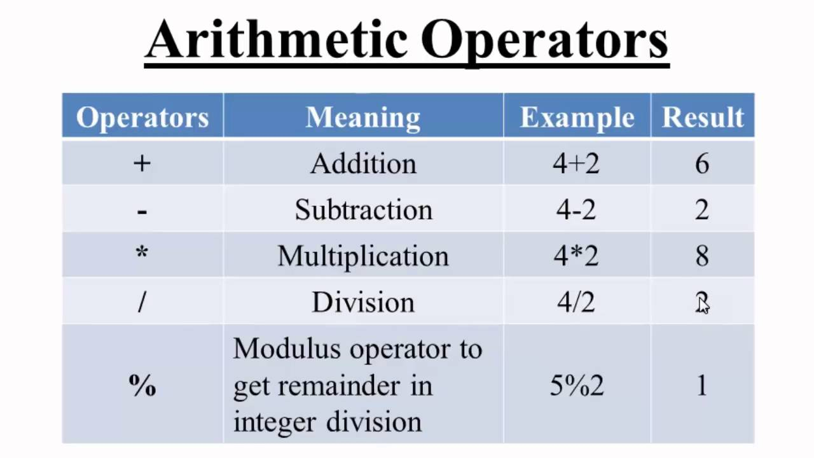
Arithmetic Operator
Operators used to perform mathematical operations.
For addition ‘+’
For multiplication ‘*’
For subtraction ‘-’
For division ‘*’
For modulus ‘%’

Slide 14
PEMDAS Order
Please Excuse My Dear Aunt Sally
Parenthesis.
Exponents.
Multiplication or Division. [Whichever comes first]
Followed by Addition or Subtraction. [Whichever comes first]
So let us look at some math: (7+(3*15-8)*2/6-4)/9

Slide 15
Division Operator
Results of an algebraic or arithmetic operation depends on the data type of the operands
This becomes problematic for division operations in particular
int / int -> int
double / double -> double
So, 7/5 == 1
If you want a decimal number then you need to convert one of the operands to floating-point e.g : 7.0/5 == 1.4

Slide 16
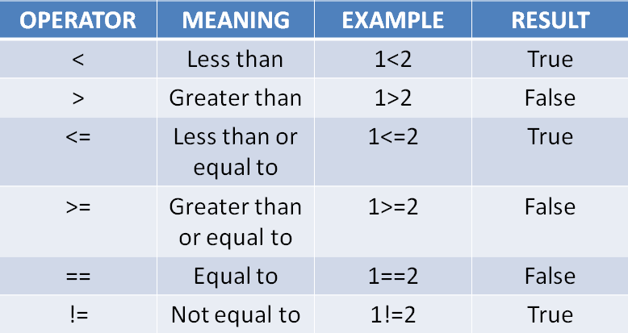
Relational Operator
Relational operators are used for comparison of the values of two operands.

Slide 17
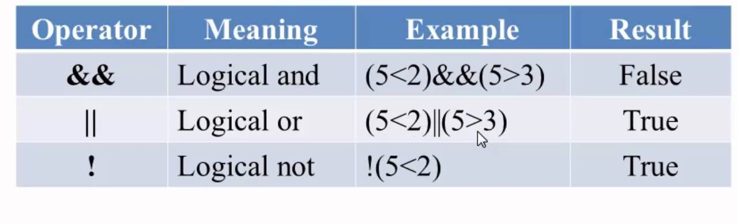
Logical Operator
Logical Operators are used to combine two or more conditions/constraints or to complement the evaluation of the original condition in consideration. The result of the operation of a logical operator is a boolean value either true or false.

Slide 18
Logical Operators
&& | AND | New relational expression is true if both expressions are true. Binary operator
|| | OR | New relational expression is true if either expression is true. Binary operator
! | NOT | Reverses the value of an expression – true expression becomes false, and false becomes true. Unary operator

Slide 19
&&
#include<iostream>
using namespace std;
int main()
{
string day; string hour;
cout<<"Day";
cin >> day;
cout<<"Hour";
cin>> hour;
if (day =="monday" && hour == "1.40pm")
{cout<<"Today there is a CSC class";}
else {cout << "Don’t know"<<endl;}
return 0;
}

Slide 20
#include<iostream>
using namespace std;
int main()
{
string day; string hour;
cout<<"Day";
cin >> day;
if (day =="friday" || day == "sat")
{cout<<"Today is weekend";}
else {cout << "Please go back to work"<<endl;}
return 0;
}

Slide 21
#include<iostream>
using namespace std;
int main()
{
string day1 = "monday";
string day2 = "tuesday";
if (!((day1 == "friday" ) && (day2 == "saturday")))
{cout<<"Its weekday"<<endl;}
else {cout << "Its weekend, finally !!!"<<endl;}
return 0;
}

Slide 22
Logical Operators Precedence
! has highest precedence, followed by &&, then ||
!
&&
||
Always use parentheses if you are unsure about precedence

Slide 23
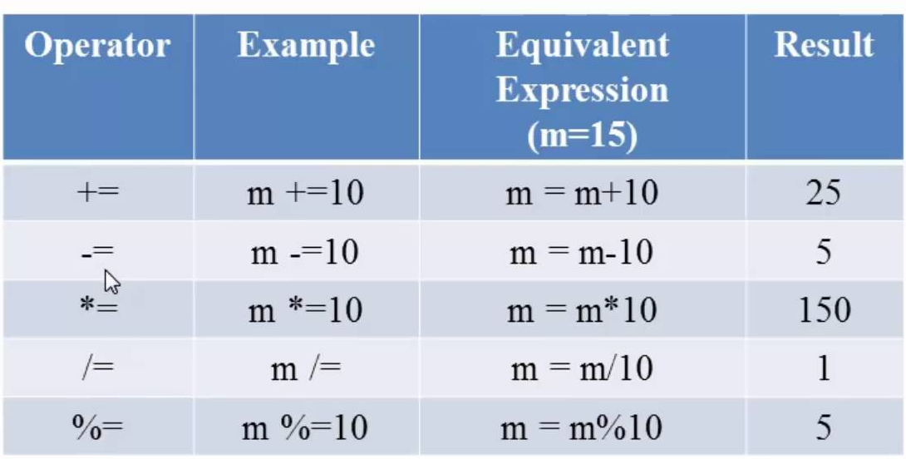
Assignment Operator
Assignment operators are used to assign value to a variable. The left side operand of the assignment operator is a variable and right side operand of the assignment operator is a value.

Slide 24
A few more operators
Shorthand Operators
Combine addition and assignment : +=
Combine multiplication and assignment : *=
Combine other arithmetic operators and assignment : -=, /=, %= …
E.g:
x = x + 17; is equivalent to x += 17;
x = x - 17; is equivalent to x -= 17;

